Slide 1
Diversity, Equity and Inclusion Team
Plainfield Public Schools
January 9th 2023

Slide 2
Who is in the room?
Introduction of members

Slide 3
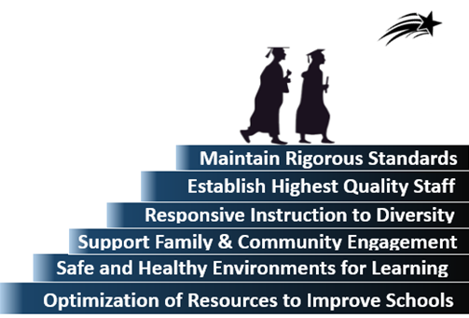
Mission
To Prepare ALL Students To Lead Safe and Healthy Lives
With The Skills to Become Productive Members
Of the Community & the Workforce

Slide 4
What is DEI?

Slide 5
Diversity
Diversity Refers To All Aspects of Human Difference, Social Identities, and Social Group Differences, Including But Not Limited to Race, Ethnicity, Creed, Color, Sex, Gender, Gender Identity, Sexual Identity, Socio-Economic Status, Language, Culture, National Origin, Religion/Spirituality, Age, (Dis)ability, and Military/Veteran Status, Political Perspective, and Associational Preferences.

Slide 6
Equity
Equity Refers to Working Toward Fair Opportunities and Outcomes For Everyone By Removing Barriers That Often Result In Unique Challenges and Disadvantages. Historic-Current. Equity Is Different Than Equality In That Equality Implies Treating Everyone the Same As If Their Experiences Are Exactly the Same.

Slide 7
Inclusion
Inclusion Is About Achieving An Environment Which Those In It Feel Respected, Have a Sense Of Belonging, Are Granted Equal Access To Opportunities and They Can Contribute Fully To Whatever Environment They Are In To Achieve Their Full Potential.

Slide 8
Purpose of DEI Team
Support District Mission, Vision, and Core Values
Develop Policies and procedures for Plainfield schools
Provide Professional Development for staff
Identify and understand root causes of inequities that may exist within and across communities
Support the social and emotional needs of all learners
Develop a plan and process to address inequities by
Explore differences in cohort achievement.
Review access to programs among cohorts.
Examine racial disparities among cohorts.
Provide opportunities for staff development

Slide 10
Developing an Equity Statement
Newtown Public Schools | Mansfield Public Schools | Westport Public Schools
Mission The PEAC Diversity, Equity and Inclusion Sub-group commits to partnering with the Newtown Public School Schools in the journey to cultivate, nurture and sustain a safe, respectful and inclusive culture across the district. Vision We intend to recognize the integrity of diversity and to inspire dialogue and forge community bond | District Equity Statement: Lead with Equity We believe that children must be supported to learn and develop in a safe, antiracist environment free from discrimination, bias, and prejudice against all people, where conscious efforts and intentional actions ensure equitable opportunities. | Our global community is multicultural with interconnected communities and social needs. In this landscape, innovation and growth are also happening at the intersection of diverse perspectives. To help prepare our students to thrive in this context, our committee’s mission is to: “Teach our children and ourselves to live, learn, and work together in a diverse and interconnected world; and to respect, support, and value all."

Slide 11
Developing an Equity Statement
Farmington Public Schools | Fairfield Public Schools | Westport Public Schools
In Farmington, we want every child to feel cared for as an individual and as a member of our school and classroom communities. In partnership with families, students, faculty, and staff, we seek to uphold equity as a fundamental value of public education – a value that embraces diversity as an asset to our school community. We recognize that students come to us with diverse experiences, interests, and needs. It is therefore essential that all students have access to challenging and personally meaningful curriculum and instruction. Teachers, administrators and staff are committed to the pursuit of excellence for all students, meeting them where they are, and providing resources, flexible pathways, and targeted support to remove barriers to opportunity. We believe that equity is a fundamental value of a high quality education and that diversity is an asset to our school community. | Fairfield Public Schools is committed to providing a high quality education which supports the needs of all learners, regardless of age, race, identity, religious beliefs, political affiliation, or special needs. Our classrooms and schools value each person as an individual and we implement programs to help our educators provide the best culture and climate for all students to be successful. | The Norwalk Board of Education firmly believes in the potential of all students to learn and succeed. We support equity, diversity and inclusion as fundamental values of our school district to ensure access for ALL scholars. We stand united in respecting people of all backgrounds and identities, welcoming all races, socio-economic statuses, genders, gender identities or expressions, sexual orientations, religions, nationalities, citizenship statuses and disabilities. Our schools are safe and welcoming environments for all. We are dedicated to fostering authentic relationships with all members of our school community, including culturally diverse families, and will communicate with clarity and respect. To prepare our students to succeed in a multi-cultural, global society, we support our schools in teaching the contributions and viewpoints of all people, using culturally relevant curricula. Race/ethnicity, language or socio-economic status will not be barriers to accessing academic, social-emotional and extra-curricular opportunities. The Board believes that a high quality school district provides equitable opportunities, policies, facilities and experiences that produce meaningful outcomes for ALL scholars.

Slide 12
Developing an Equity Statement
A commitment to building positive, purposeful relationships with every student and every family so that barriers to learning at high levels are removed. Diversity among Ritenour families and staff is valued, sought, and embraced. Student backgrounds (racial, ethnic, religious, gender, class, traumatic experiences) do not limit teacher expectations on student outcomes. Resources are allocated so that every student gets what they need. | At the Ford Foundation, diversity, equity, and inclusion are at the core of who we are. Our commitment to these values is unwavering – across all of our work around the world. They are central to our mission and to our impact. We know that having varied perspectives helps generate better ideas to solve the complex problems of a changing—and increasingly diverse—world. | Our accelerated approach to diversity and inclusion Google’s mission is to organize the world’s information and make it universally accessible and useful. When we say we want to build for everyone, we mean everyone. To do that well, we need a workforce that’s more representative of the users we serve. That’s why we’ve embraced a refreshed and accelerated approach to diversity and inclusion.

Slide 13
Questions to consider as you look at these statements
What is a DEI commitment statement?
How is a DEI commitment statement useful?
How does a DEI commitment statement differ from an Equal Opportunity or Reasonable Accommodation statement?
What should be included?
What do you think makes an effective DEI commitment statement?

Slide 14
Establishing Topics for future Meetings
February:
DEI commitment statement
Part 1 of Equity Audit
April:
Part 3 of Equity Audit
Development of Goals/Targets
March:
DEI commitment statement finalized
Part 2 of Equity Audit
May:
Completion of Goals/Targets

Slide 15
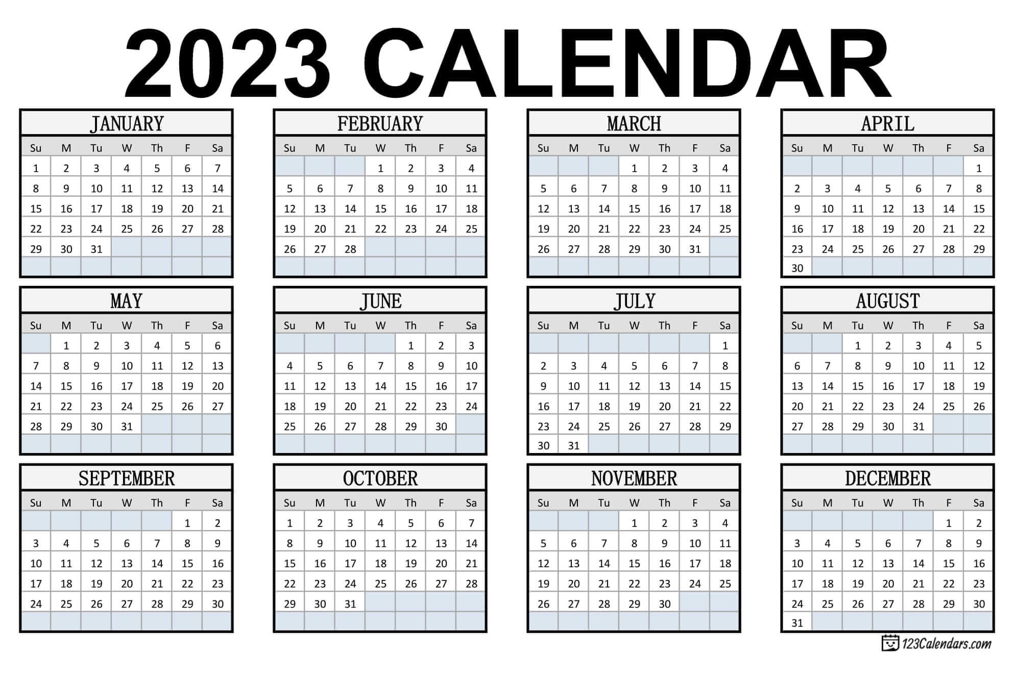
Open discussion of time and dates for future meetings

Slide 16
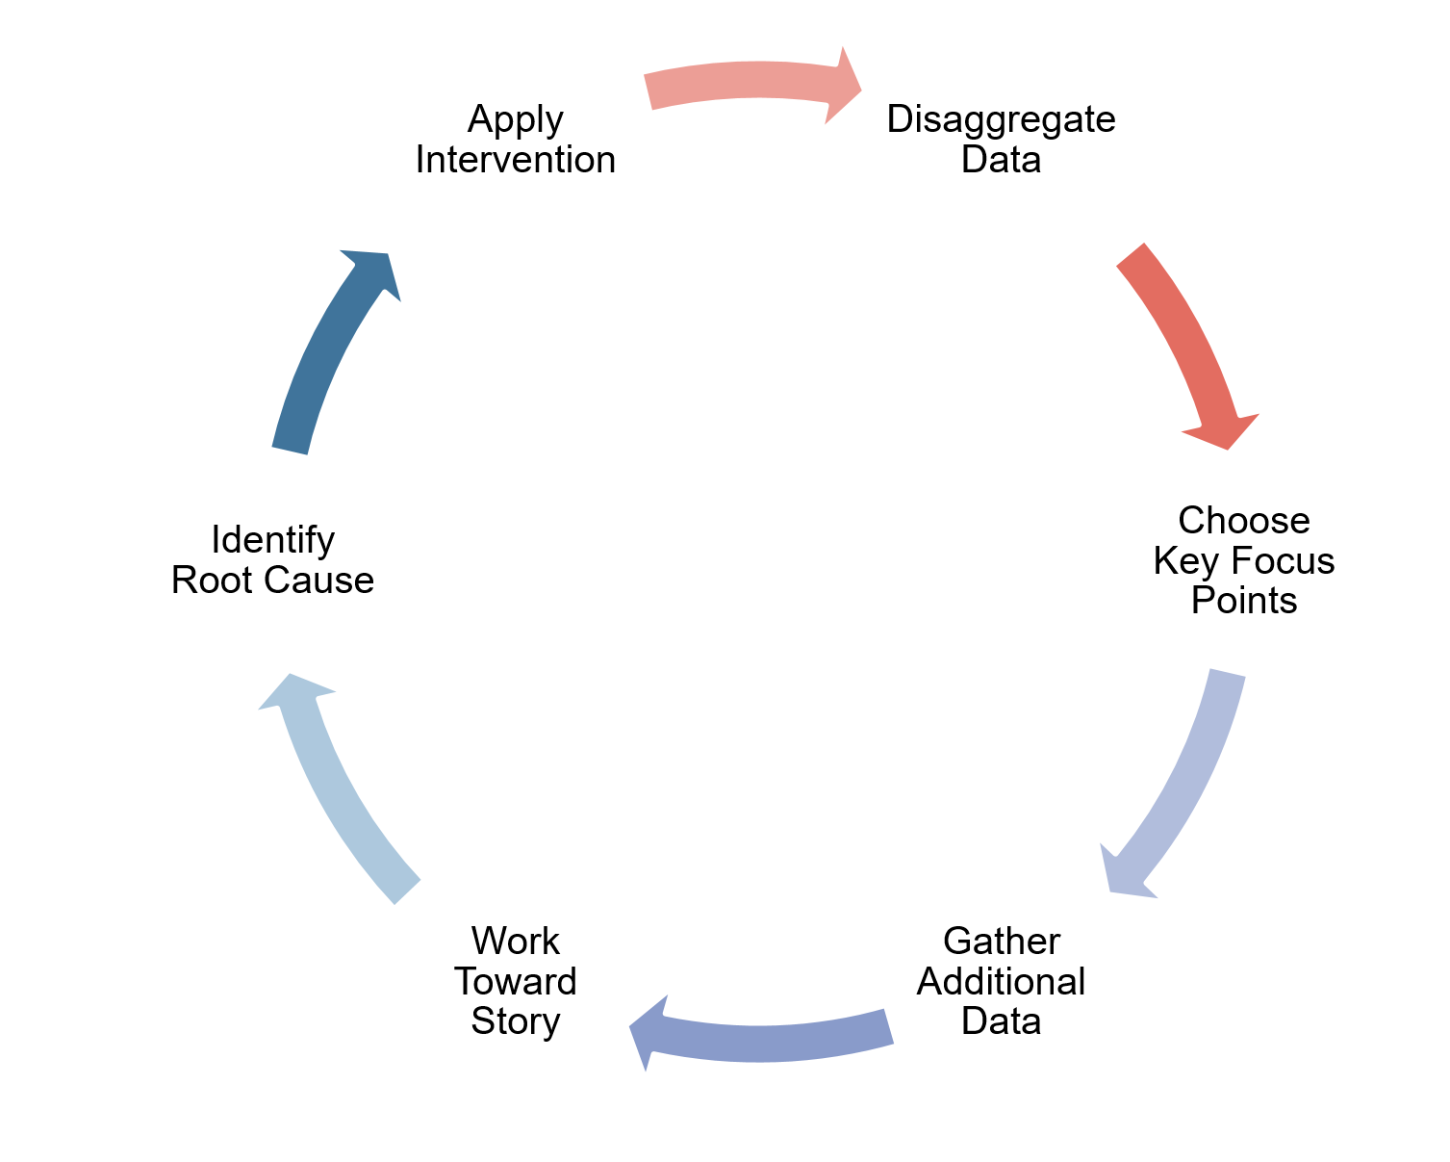
Equity Audit
Solution Cyle

Slide 17
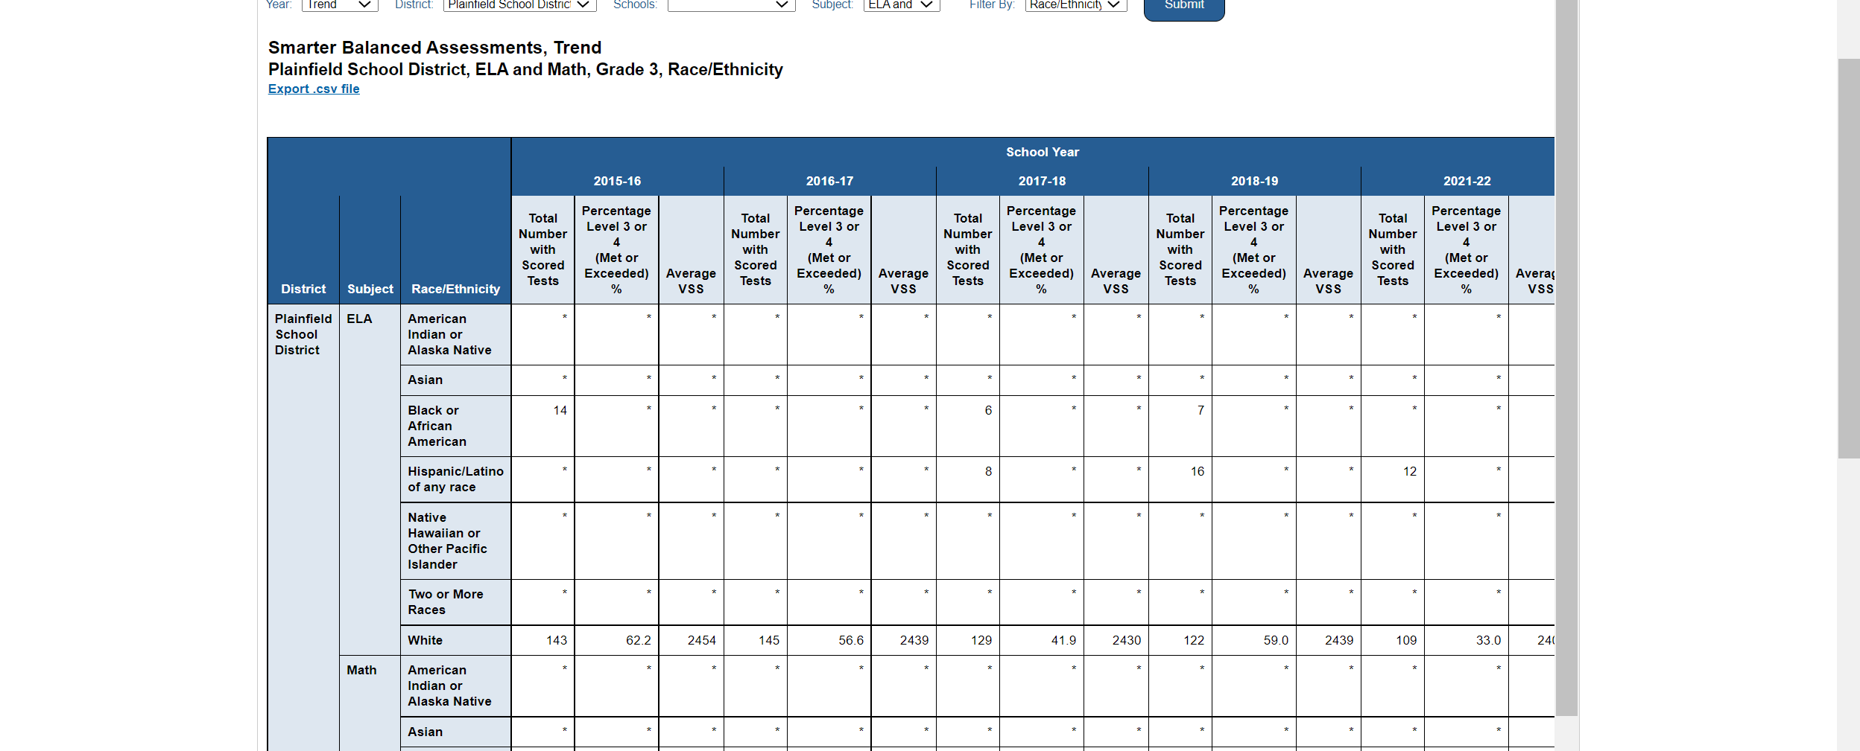
What does this data look like

Slide 18
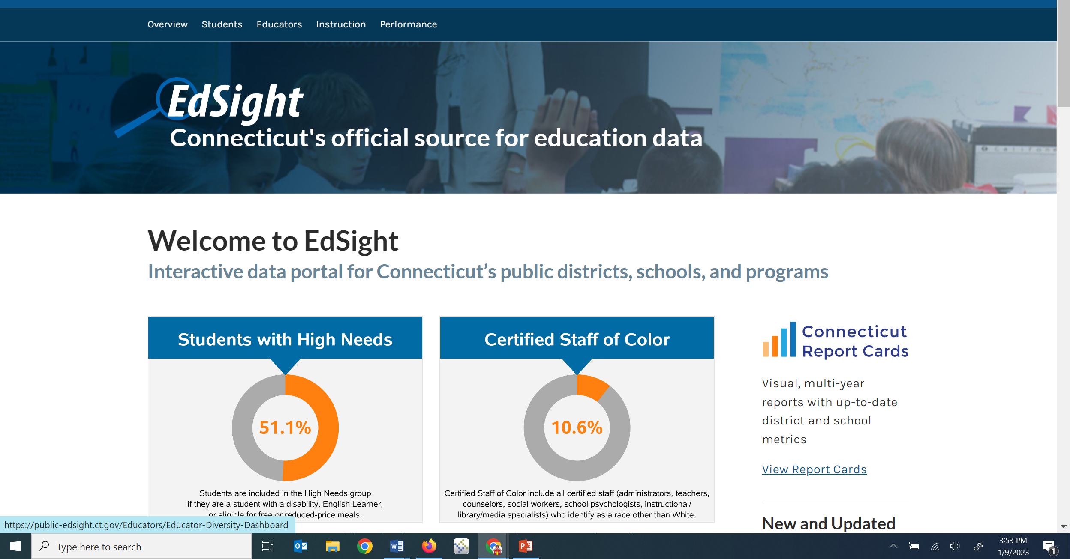
How can we dig deeper into data?

Slide 19
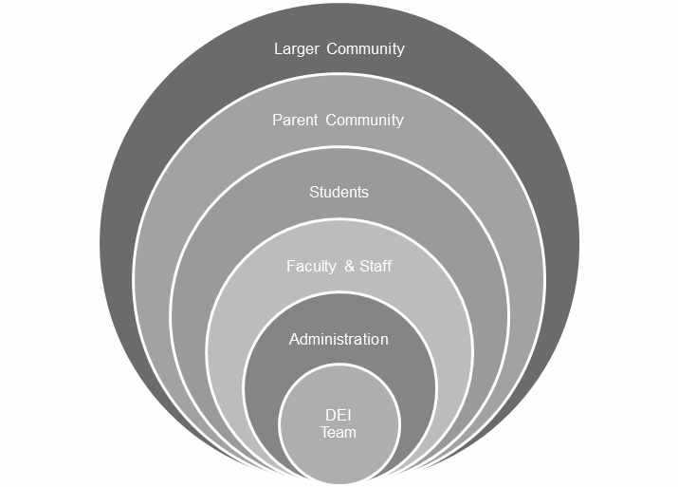
Open Invitation to invite guests

Slide 20
Ending Well

